Slide 1
Robotics at a Distance
Tony Hirst
Computing and Communications, The Open University
blog.ouseful.info
github.com/innovationOUtside

Slide 2
Challenges and Opportunities
Remote Robot Labs
Robot Simulators / Simulated Activities
See also: simple-robot-simulator-review
https://github.com/ouseful-demos/simple-robot-simulator-review

Slide 3
Remote Robot Labs
Student logs in to a remote laboratory
Lab provides one or more video feeds onto:
mobile robot in a robot arena
static robot (eg Baxter) on a workbench
Student connects to robot and runs robot control program
Student collects telemetry data and watches video feed
Available off the shelf? NO

Slide 4
Robot Simulators / Simulated Activities
Workflow:
connect to simulator;
runs robot control programme;
collects telemetry, and
Watches resulting robot behaviour.
So how does that work in practice?

Slide 5
Where Does The Simulator Run?
Student’s local machine
Ease of software installation
Download size (connectivity)
Disk requirements (GB)
RAM / memory requirements (GB)
GPU requirements
Remotely hosted
Provided by institution
Self-hosted (Resource requirements? Installation? Access?

Slide 6
Simulator UI
How is the simulator UI published?
Browser based?
Desktop application?
For remote access desktop applications, require remote desktop provision, either via:
Browser based remote desktop (eg novnc, xpra)
Remote desktop protocols (eg RDP) connected to via desktop client

Slide 7
Challenges
Support to date for installing and running robot control platforms and simulators SUCKS.
We want students to spend as much time as possible running robot programmes
NOT
Engaging in technically complex, time-consuming, once only, software installation, commissioning, and maintenance.

Slide 8
Opportunities
Infrastructure
Clear guidance on how to set up:
Personal remote hardware infrastructure
Personal remote access tools
Appropriate institutionally hosted multi-user environments
Off-the-Shelf environments providing:
Robot programming environment
Robot simulator
(Virtual desktop to run desktop robot simulator)
Clear guidance on how to install and run off-the-shelf environments
On personal local infrastructure
On remote infrastructure
In institutional multi-user environment

Slide 9
On My Watchlist (1)
Webots – fully featured, “industry strength”
Apache 2.0 license
3D simulator with wide range of robot modules
Browser based UI
ROS compatible
Local desktop use BUT ideally requires a GPU and a reasonable spec machine
Local and Remote operation (e.g. free minimal resource online hosted service at robotbenchmark.net)
Docker container WIP
Programming from Jupyter notebook
Accessed via a browser
https://github.com/RobInLabUJI/Webots-Docker

Slide 10
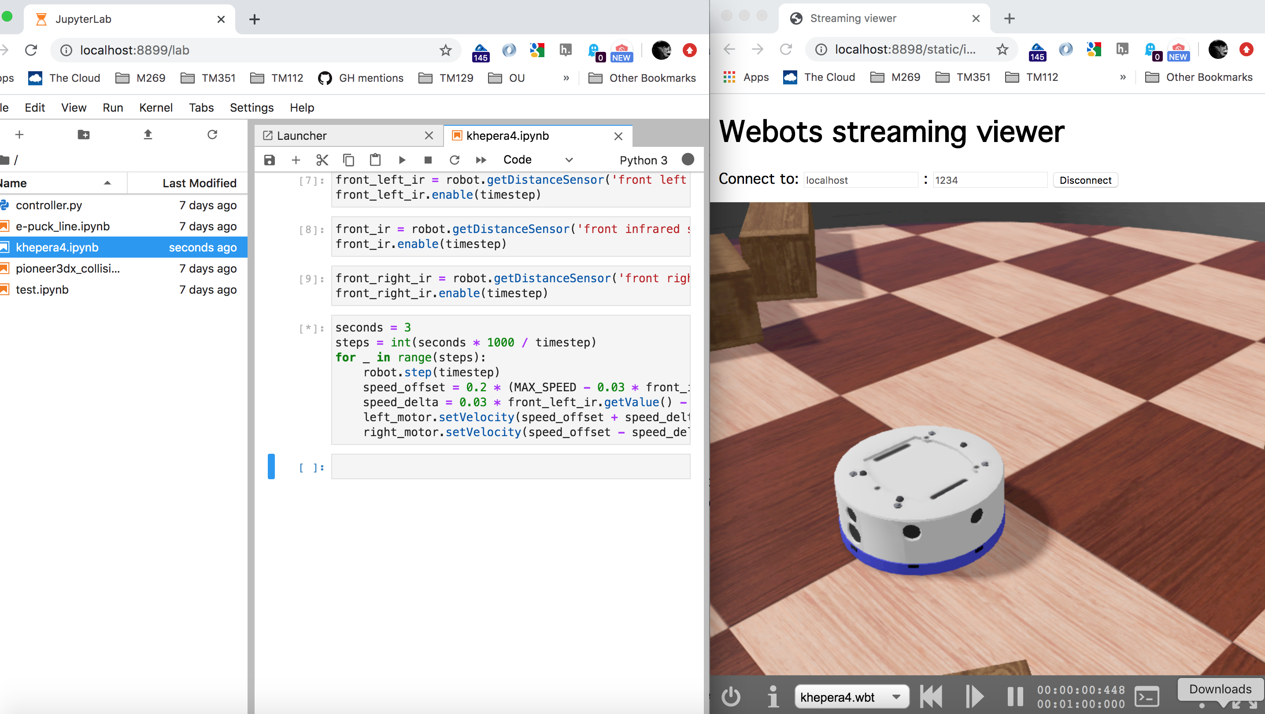
github.com/RobInLabUJI/WebotsLab

Slide 11
On My Watchlist (2)
ev3devsim – lightweight, simple as possible
Simple 2D simulator (browser based / JS / Skulpt)
Runs ev3dev Python (Lego EV3 compatible)
Runs in browser
Standalone demo, [repo]
WIP – Jupyter ipywidget [nbev3devsim]

Slide 12
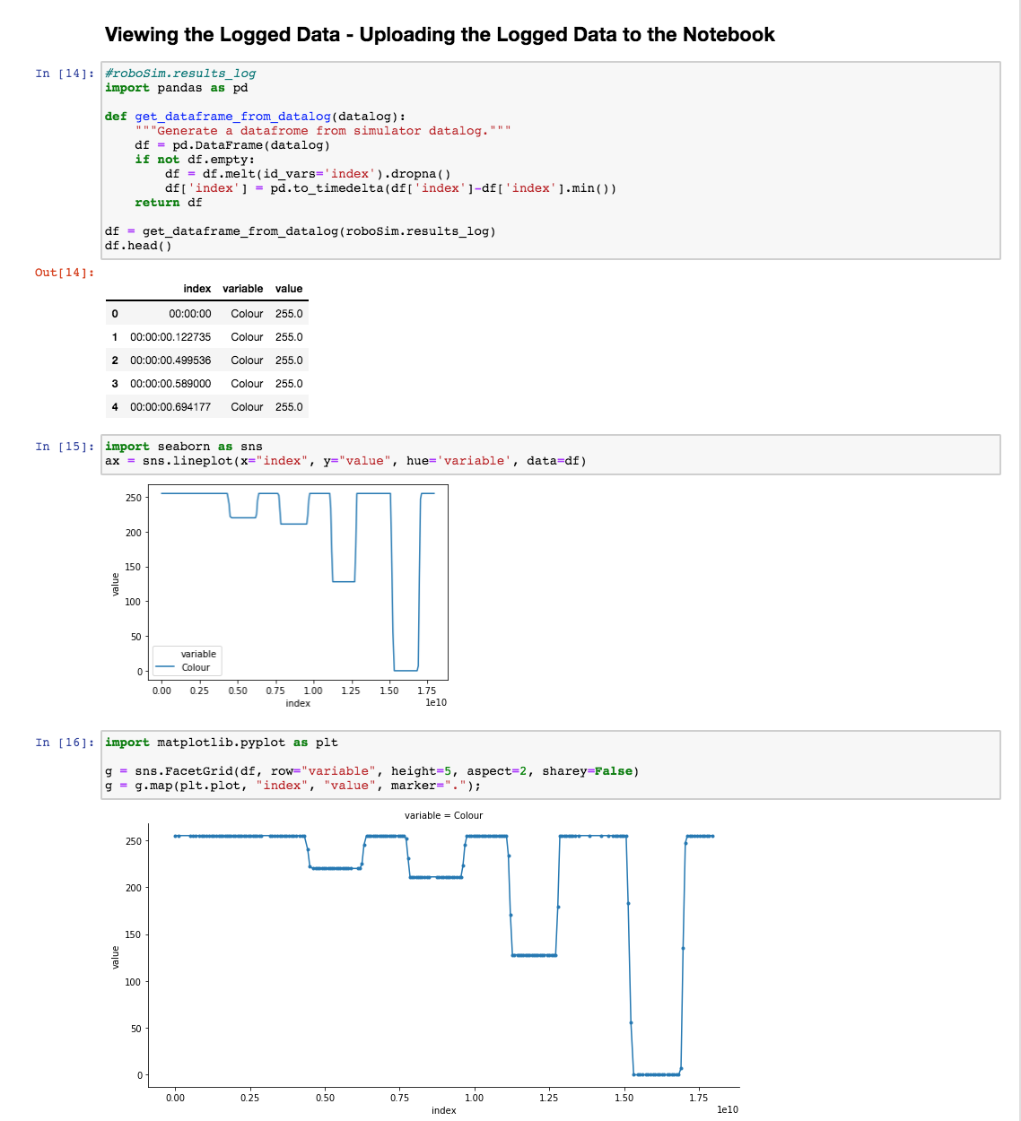
github.com/innovationOUtside/nbev3devsim

